Slide 1
ECLI implementation in
ITALY
State of play
ECLI Conference Athens | 8-9 June 2017
Tommaso Agnoloni
Ginevra Peruginelli
Lorenzo Bacci
Coordinator BO-ECLI WS1 - Italy
agnoloni@ittig.cnr.it
This project is co-funded by
the European Union
Notes:
presentation regarding the state of play of the implementation of ECLI within Italy. The presentation does not have to be very long, but could focus on an the progress in your implementation and the main challenges you have faced.

Slide 2
Italian courts in ECLI
Corte Costituzionale (ECLI:IT:COST)
Corte Suprema di Cassazione (ECLI:IT:CASS)
Corte dei conti (ECLI:IT:CONT)
Consiglio di Stato (ECLI:IT:CDS) and administrative justice
ECLI Conference
8th June 2017
Athens
Notes:
Feel free to manage – design – arrange your content in one, two or more columns at the above two rectangular areas!

Slide 3
Corte Costituzionale (COST)
Constitutional Court
Indexed on ECLI SE of e-Justice portal since November 2016
Approx 20.000 decisions / growth rate per year approx. 300
Complete archive of published decisions
ECLI:IT:COST:year:number ECLI:IT:COST:2016:250
ECLI Conference
8th June 2017
Athens
Notes:
Feel free to manage – design – arrange your content in one, two or more columns at the above two rectangular areas!

Slide 4
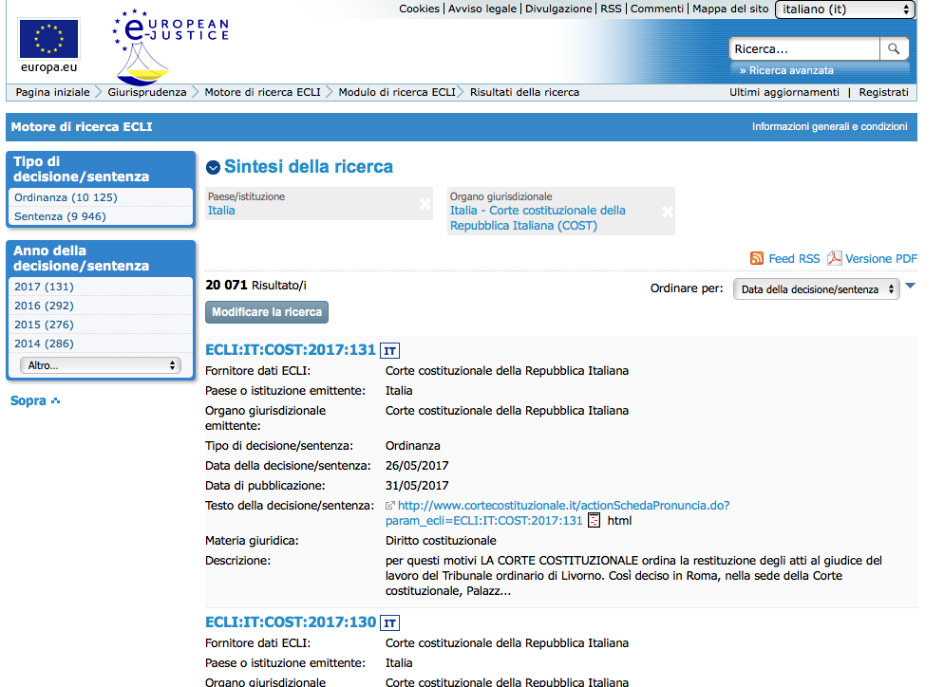
ECLI Conference
8th June 2017
Athens
Notes:
Feel free to manage – design – arrange your content in one, two or more columns at the above two rectangular areas!

Slide 5
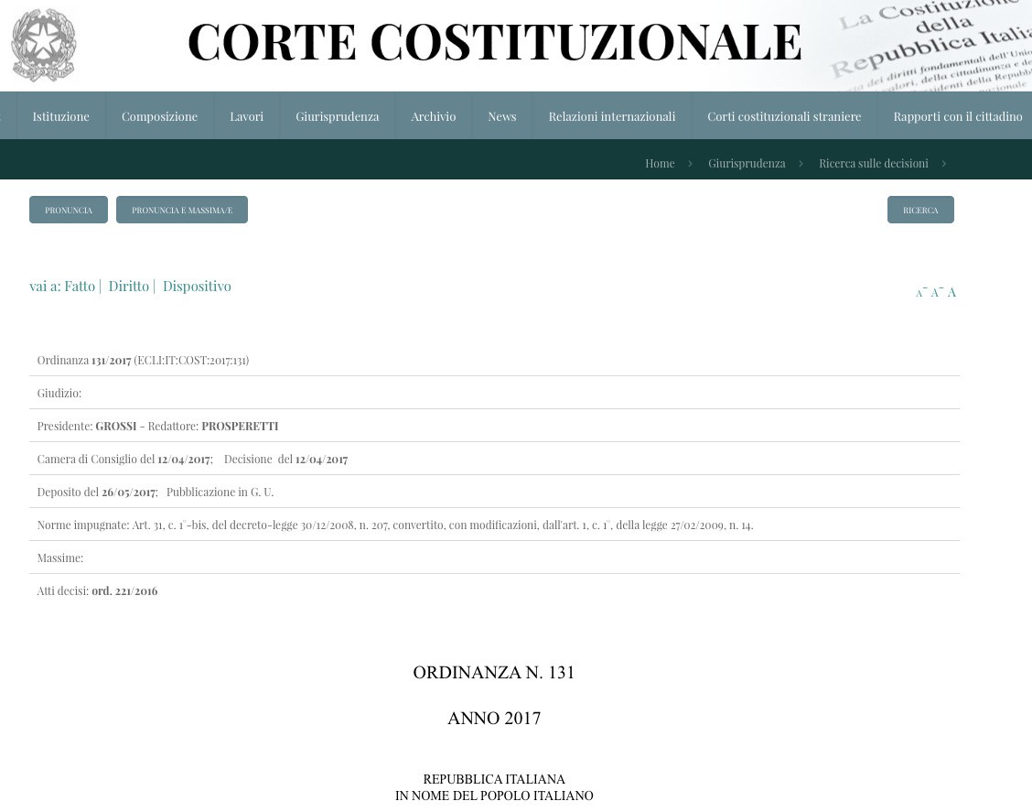
ECLI Conference
8th June 2017
Athens
Notes:
Feel free to manage – design – arrange your content in one, two or more columns at the above two rectangular areas!

Slide 6
Corte Suprema di Cassazione (CASS)
Supreme Court of Cassation
Indexed on ECLI SE of e-Justice portal since January 2017
Approx. 1.1 millions decisions / growth rate per year approx. 80.000
Archive of decisions published on italgiure.giustizia.it
Judicial decisions on Civil (CIV) and Criminal (PEN) matters
ECLI:IT:CASS:1994:10189CIV
ECLI:IT:CASS:2002:22539PEN
public: decisions issued within last 5 years (full-text)
private: access with credentials to Italgiure for full-text of older decisions
ECLI Conference
8th June 2017
Athens
Notes:
Feel free to manage – design – arrange your content in one, two or more columns at the above two rectangular areas!

Slide 7
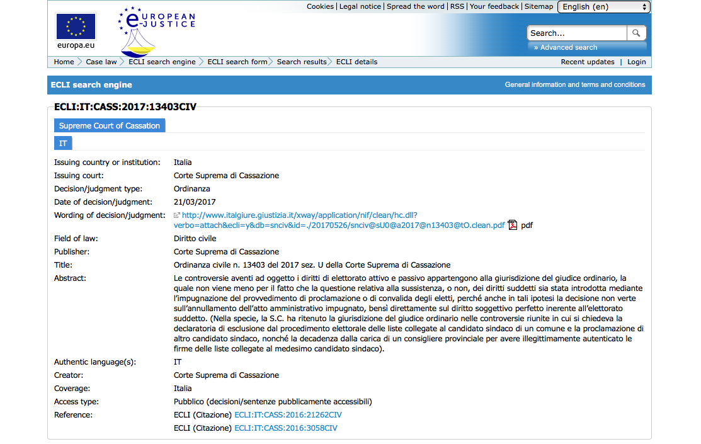
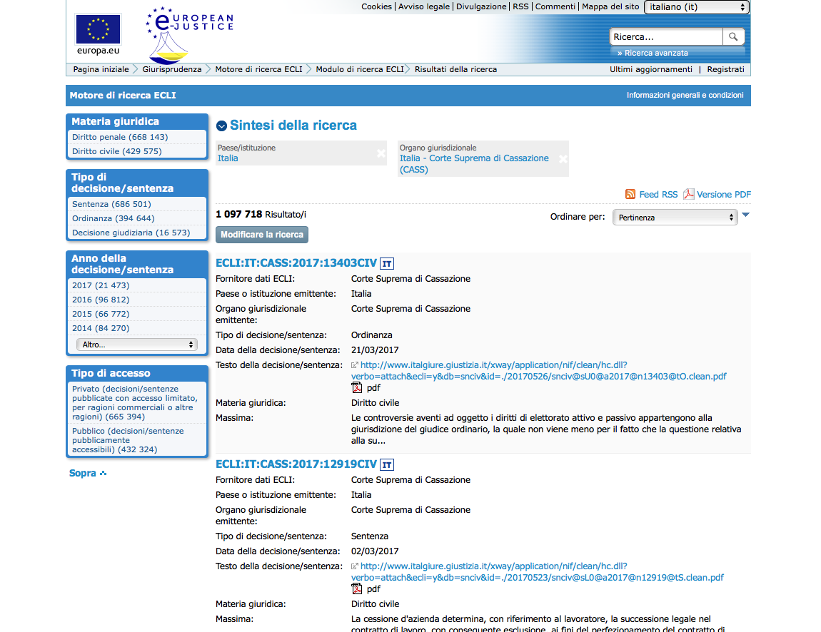
ECLI Conference
8th June 2017
Athens

Slide 8
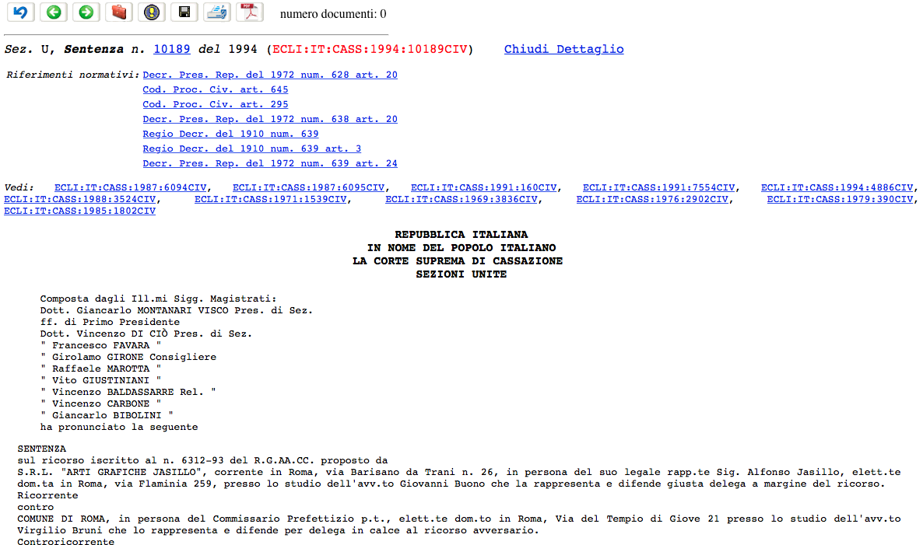
ECLI Conference
8th June 2017
Athens
Notes:
Feel free to manage – design – arrange your content in one, two or more columns at the above two rectangular areas!

Slide 9
Corte dei conti (CONT)
Court of auditors
Currently indexed on ECLI SE test environment (May 2017)
Approx. 260.000 decisions / avg. growth rate per year approx. 15.000
Complete archive of decisions. Also published on corteconti.it
Central (united/appeal) and regional jurisdictional sections
ECLI:IT:CONT:2014:5SSRR
ECLI:IT:CONT:2011:634APP2
ECLI:IT:CONT:2015:134SGPIE
ECLI:IT:CONT:2003:567SGVEN
New ecli:subject “Public Accounting Law”
ECLI Conference
8th June 2017
Athens
Notes:
Feel free to manage – design – arrange your content in one, two or more columns at the above two rectangular areas!

Slide 10
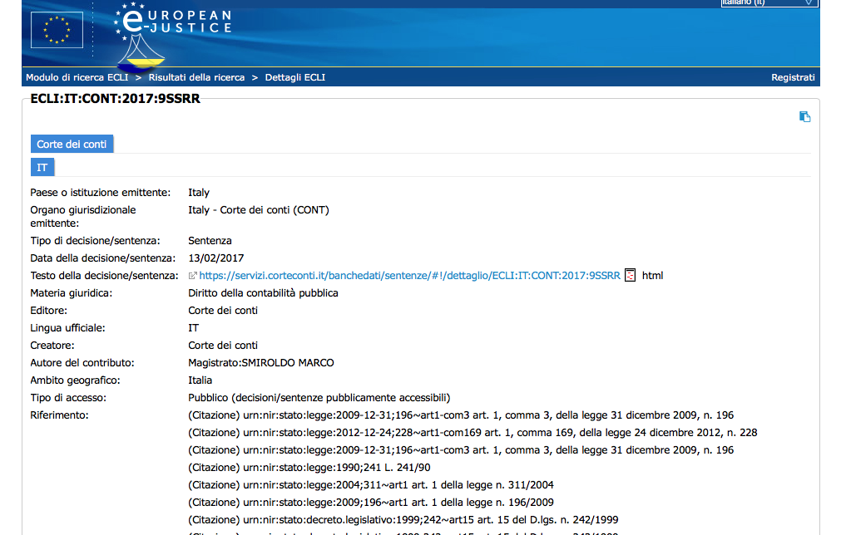
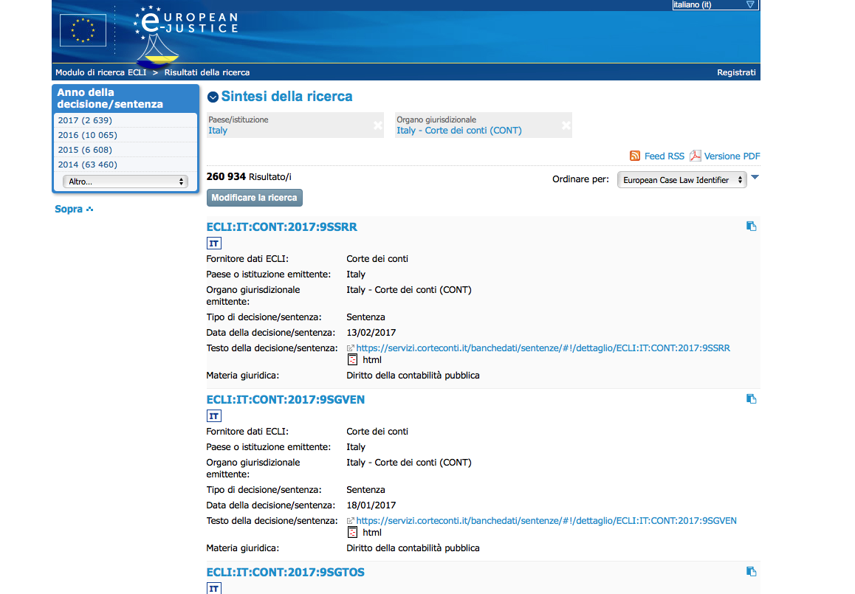
ECLI Conference
8th June 2017
Athens

Slide 11
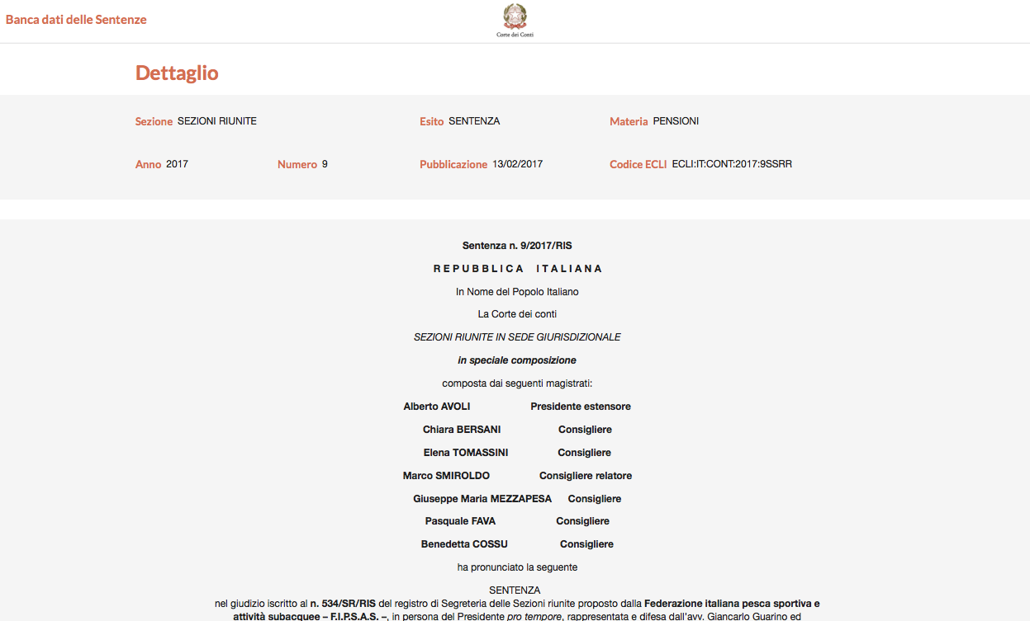
ECLI Conference
8th June 2017
Athens
Notes:
Feel free to manage – design – arrange your content in one, two or more columns at the above two rectangular areas!

Slide 12
Consiglio di Stato (CDS)
Council of State (and Regional Administrative Tribunals)
Under development (to be completed by September 2017 )
Approx. 2 millions decisions / avg. growth rate per year approx. 100.000
Complete archive of decisions (giustizia-amministrativa.it)
Council of State (CDS) and regional administrative tribunals (TAR)
ECLI:IT:CDS:2016:ordinal_number
ECLI:IT:TARLAZ:2016:ordinal_number
ECLI:IT:TARTOS:2016:ordinal_number
(30 new Court Codes: Council of State + 29 TAR)
Ordinal number under analysis (number disambiguation based on internal registries)
ECLI Conference
8th June 2017
Athens
Notes:
Feel free to manage – design – arrange your content in one, two or more columns at the above two rectangular areas!

Slide 13
FUTURE DEVELOPMENTS
Enrichment of ECLI Metadata (e.g. references, keywords)
First instance judgments on Civil matters (PCT - Civil Online Trial)
currently available as prototype implementation - to be revised and indexed in ECLI search engine
Extension to first instance criminal judgments
Courts of Appeal in ordinary jurisdiction
ECLI dissemination to Italian judges and legal professionals
ECLI Conference
8th June 2017
Athens
Notes:
Feel free to manage – design – arrange your content in one, two or more columns at the above two rectangular areas!

Slide 14
Thank you for your attention!
This presentation has been produced with the financial support of the Justice Programme of the European Union. The contents of this publication are the sole responsibility of the partners of the BO-ECLI project and can in no way be taken to reflect the views of the European Commission.
This project is co-funded by
the European Union

